Slide 1


SPARKS 2
Export Controls

Slide 2
Overview
Export Controls at UCF
Acts & Regulations
Proposal/Award Reviews
Non-Research Issues
Denied Entities

Slide 3
Core Departments
Human Resources
Employee Records
  Nationality
  Work Visa
  H1B (temp professional)
  H2B (temp worker)
  L1A (temp alien)
  O1 (temp alien w/ abilities)
Sponsored Programs
“Redflag” agreements, grants, etc.
Initial screen for EC issues
Collect prelim . Data
Inform PI of potential issues
Ascertain Foreign National
involvement
Travel screens
General Counsel
COI / Risk Management
Investigations
Self-reporting
Export Control
Visa Office
Finance & Acct.
Program Management
Regulatory Research
Risk Assessment
Registrations
CCL / USML Classification
Licensing
Exception/Exemptions
Technology Control Plans
Training
Records Management
Visual Compliance
Program Assessment
  Visa
  H1B (employee)
  F1 (regular student)
  J1 (scholars)
  B-type “ghosts”
Purchasing
Sanctioned financial
transactions (OFAC)
ECCN / USML category
determinations from suppliers
>$75K mandatory CCL/USML
for all solicitations
Surplus auctions
Professional Services info
Provide training and contact
with ECO for ECCN.
Travel
Preliminary Travel Screens
Shipping
Admissions
International Shipments
Country of citizenship
Sponsor (country, govt, etc)
Academic Institution data
International MOUs
Property
Env. Health & Safety
Inventory of CCL/USML items
Property accountability
3rd Party property tracking
Decaling
Identification of chem/bio &
Database of staff usage
Security of ITAR/EAR
Chemicals
Tangible shipping of CCL items
International Programs
Screens:
foreign universities
Scientific Mobility Programs
Memoranda of Understanding
Exchange Programs

Slide 4

Key Areas for EC Review
Sponsored Programs
Technology Transfer
Military Proposals
Funded Contracts, Grants
SBIR, STTR & DoD/NASA Flow-thru
Certain Non-sponsored activities
Patents / Secrecy Orders
Suspicious contacts
Unsolicited sponsorship requests
Filming requests
Invitations to foreign conferences
Misrepresentations of qualifications
Foreign large dollar donations
Visa applicants & Visitors
H-1B
J-1 / denied entities
B “Ghosts”
International Travel
Regulation updated
Sanctioned Countries / Travel Warning
Conferences
Intl Travel Committee
Federal Register / GAO Reports
Rule changes
Equipment
Licensing / tech control plans
Vendors
ITAR Equipment
EAR Deemed Export Threshold
Applications
Commodity Jurisdiction
Registrations
Collaborations
Other
MOU’s & Foreign Collaborations
Agreements, NDA’s, Imports, Cert’s

Slide 6
Main Concern for Faculty
Restricted Research
International Travel
International Collaboration
Hosting Visiting Scholars (B & J visa types)
Hiring foreign nationals (F and H visa types, I-129)
Lab equipment/instruments
Deemed exports / defense services in Research
  Proprietary, Military , Accepting restrictions (even if unaware). Input, Conduct, Output

Slide 7
Recent Enforcement
2013, NYU researchers bribed by CN Govt for NIH MRI grant tech
2013, UMASS Lowell CAR shipped EAR99 atmospheric device to Pakistan Space & Upper Atmosphere Rsch Comm. $100k fine
2010, Perm Res. researcher stole Dow pesticide secret for Hunan Normal Univ. student to publish journal. 7 years, 3 months
2006, Roth AECA violation . 4 years, +2 prob; bankrupt
2004, Texas Tech Prof. imported plague bacteria. 2 years, $50k civil / $250k criminal
1998, FAU Prof export thermal camera to Syria. Pretrial diversion

Slide 8




Regs
International Traffic in Arms Regulations
Foreign Asset Control Regulations
Department of Energy & NRC
Export Administration Regulations
Arms Export Control Act
(AECA)
Export Administration Act (EAA)
TWEA & Sanctions Regs.
Atomic Energy Act (AEA), Energy Reorganization Act (ERA), Nuclear Non- proliferation Act (NNPA)
Aim of Export Compliance is to review
activities against regulatory requirements
8

Slide 9
Other Acts & Regs
Controlled Substances Act
  Agency: Drug Enforcement Administration
  Reg: Controlled Substances Regulations
Federal Food & Drug Act
Federal Rood, Drug & Cosmetic Act
Drug Export Amendments Act
FDA Export Reform and Enhancement Act
Food and Drug Administration Safety & Innovation Act
  Agency: Food & Drug Administration
  Reg: US FDA Regulations

Slide 10
Other Acts & Regs.
Plant Protection Act
Animal Health Protection Act
  Agency: Department of Agriculture, Animal and Plant Health Inspection Service (APHIS)
  Reg: USDA Regulations
Endangered Species Act
Lacey Act
Migratory Bird Treaty Act
Marine Mammal Protection Act
  Agency: Department of the Interior, US Fish & Wildlife Service
  Reg: US Fish & Wildlife Regulations

Slide 11
Other Acts & Regs
Resource Conservation & Recovery Act
Solid Waste Disposal Act
  Agency: US Environmental Protection Agency (EPA)
  Regs: US EPA Regs, Protection of Environment: Imports / Exports of Hazardous Waste
Best practice: Be aware that there are multiple regulations that can apply to multiple Colleges, Departments and various activities.

Slide 12
Identifying Restricted Research
MTA, NDA, PIA, MOU
- Science & Engineering
EAR or ITAR (recruit PI for this!!)
CFDA Number
1
Listed
Technologies in Technical Areas
8
Agreements
FAR / DFAR
Section H
CDRL Distribution Statements other than “A”
- Certain Foreign Nationals or Foreign Entity Collaboration, particular Denied Entity
- Embargoed / sanctioned countries
2
Foreign Travel, Collaboration, or Sponsor
7
Clauses
Pre-publication approval
Access, dissemination, publication or participation restrictions
6
Contractual Issues
3
Physical Exports
What,
Where,
Who
Use
6
Fundamental Research vs. Deemed Export
5
Military Research
If “yes” then
Input,
conduct,
output
SBIR, STTR, Flow-thru
NASA, DOE, Other
Specifically designed, modified, configured or adapted for military use
Advanced Technology Development
“Development, production or use” threshold
Educational, Public Domain, FRE

Slide 13
Review examines the Input, Conduct, Output
Not
Fundamental
Research
Restricted Input
Restricted Conduct
Restricted Output
Unrestricted Input
Unrestricted Conduct
Unrestricted Output
Fundamental Research
Unrestricted Input, Conduct or Output
Restricted Input, Conduct or Output
Mixed: Fundamental + Controlled
Notes:
Proposed definition clarifies that
the inclusion of defense articles in the conduct of research does not preclude the outcomes of the research from potentially qualifying as FR (2)
That said, if the output is restricted, the conduct is restricted as well.

Slide 14
Input, Conduct, Output
Restricted
Input
Fundamental Research
Mixed: Fundamental + Controlled
Not Fundamental Research
Unrestricted
Output
Unrestricted
Input
Restricted
Conduct
Unrestricted
Conduct
Restricted
Output

Slide 15
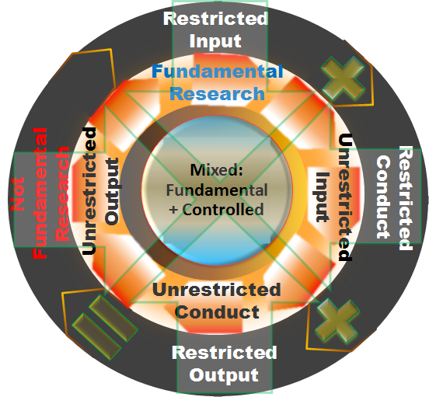
1. Red Flags?
2. Assemble Documentation
3. Inform ECO & Researchers
4. Scope & Negotiate
Upload into ARGIS
UCF Export Control Review Process
Notes:
Step 1. Review for Red Flags (Comprehensive Review Table)
Step 2. Upload & Complete EC form
Step 3. Inform Researchers (PI & Co-PI’s)
Step 4. Scope and Negotiate UCF work share
Step 5. Complete the paperwork & inform Export Controls & put into ARGIS

Slide 16
EC Proposal/Award Review Steps
Step 1. Review for Red Flags (Comprehensive Review Table)
  Sponsor, collaborator, subcontractor, consultant
    Military/Federal/Energy
    Proprietary
    Foreign
  Documents:
    Funding Announcement (Guidelines, BAA, RFP, RFQ, etc)
    Topic
    Budget Activity w/ reference to 6.3 ATD
    NDA/MTA/CDA
    Terms w/ access, dissemination, publication, participation restrictions
  Technology
    Military
    Commercial Proprietary

Slide 17
Step 2. Upload & Complete EC form
  All proposals must have the entire BAA and the Topic uploaded in ARGIS.
  Form ECO 1.1
Step 3. Inform Researchers (PI & Co-PI’s)
  Activity requires comprehensive review and will be sent to EC
  Ask the PI & Co-PI PI to identify all foreign national and US participants
  Will require TCP

Slide 18
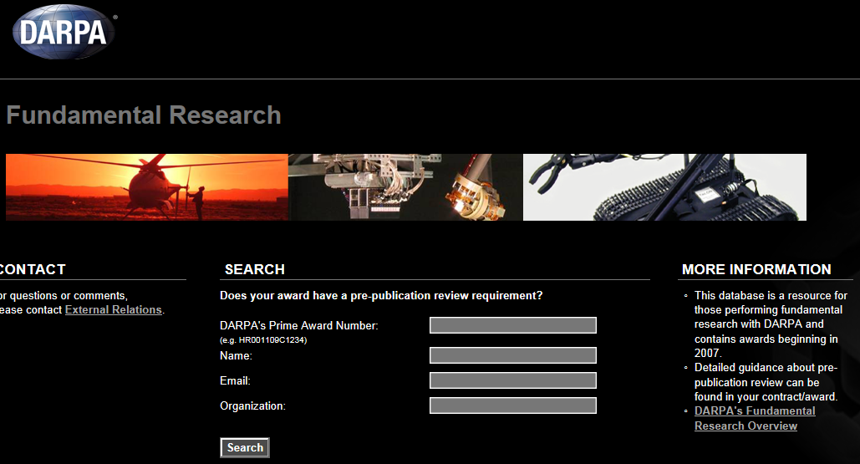
Step 4. Scope and Negotiate UCF work share
  Call/write Contracting Officer
  Invoke Ashton Carter Memo
  Get it in writing
  DARPA awards have their own website

Slide 19
Step 5. Provide the following info to EC
  Research I.D. (if available)
  PI
  College/Department
  Agency
  Solicitation/Opportunity No./BAA No.
  Title & Topic No.
  Page numbers of applicable stuff (such as references to U.S. citizen’s only, ITAR, export control restrictions, publication restrictions, or direct references to fundamental research, etc.)
  Form ECO 1.1 – Reviewed after SPARKS

Slide 20
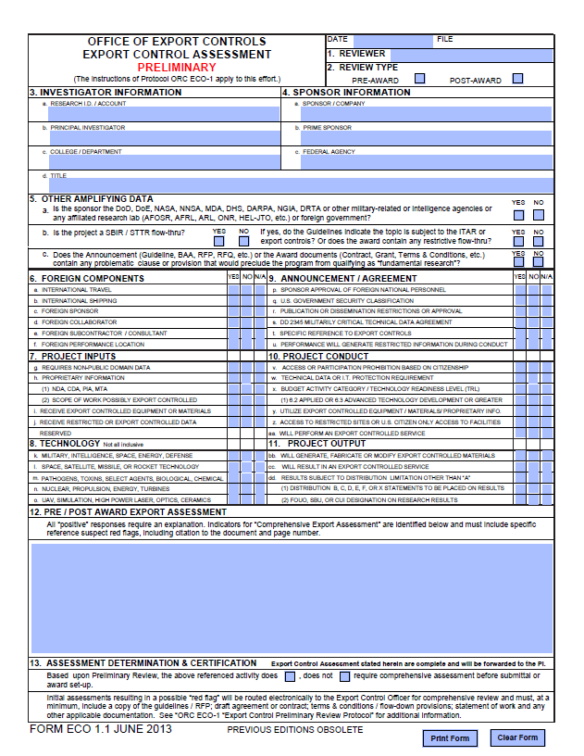

Slide 21
Red Flag Example 1: Guidelines
    “The guidelines indicate that depending on the course of the work and which program an applicant applies they may have export control restrictions.”
  This BAA is intended for proposals related to...
    basic (usually not restricted),
    applied (may be restricted) or
    advanced technology development (restricted)
  “Anticipated that this work will be fundamental research” if it is not then restrictions will appear in contract clauses or Section H upon award – tell this to the PI!!!

Slide 22
Guidelines
Eligibility Info
  Access/ Dissemination restrictions
  US Citizen only?
  Special facility access provisions?
Other info
  Security Classification (DD254)
  Reference to restriction inclusion in contract, if awarded and applicable.

Slide 23
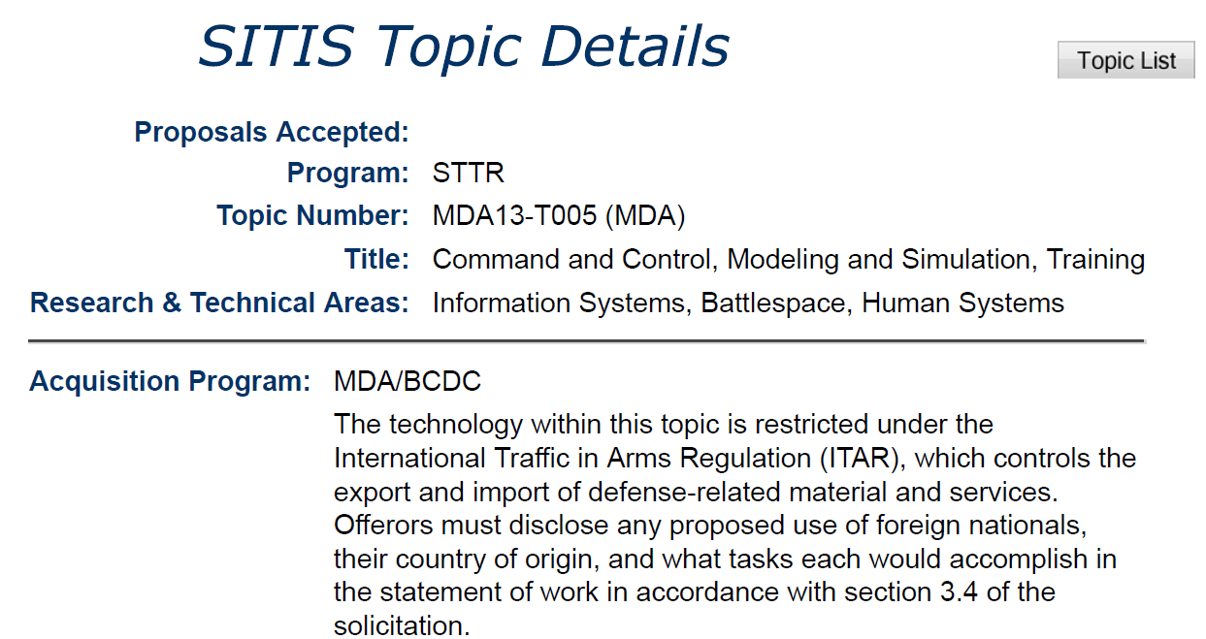
Red Flag Example 2: Topic

Slide 24
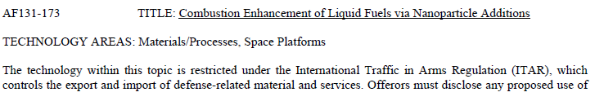
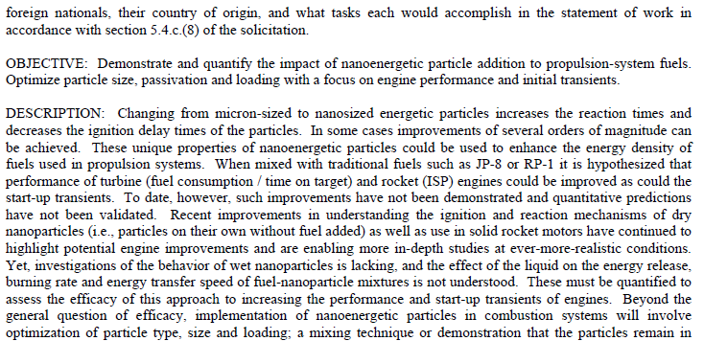
Red Flag Example 3: Topic

Slide 25
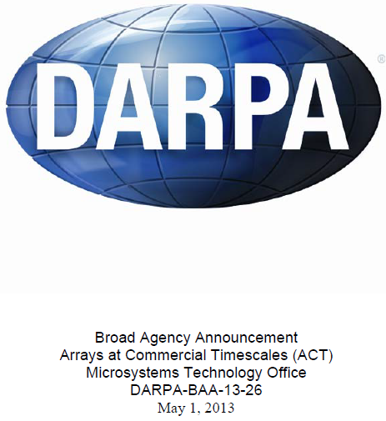
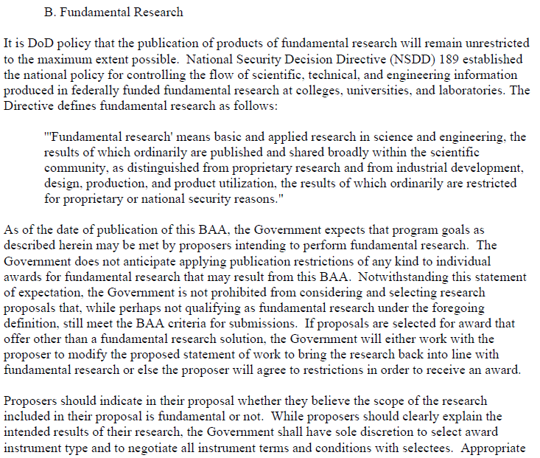
Example 4: Award Info

Slide 26
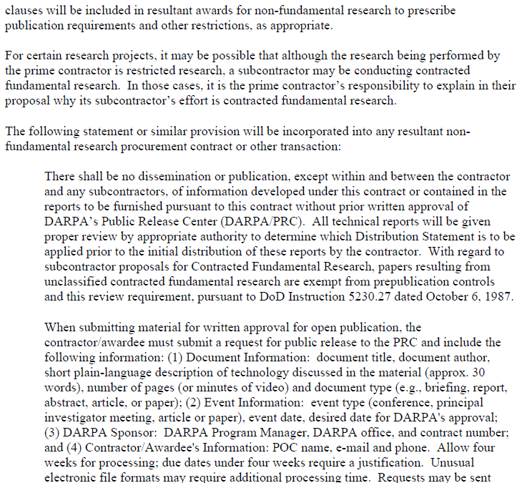

Slide 27
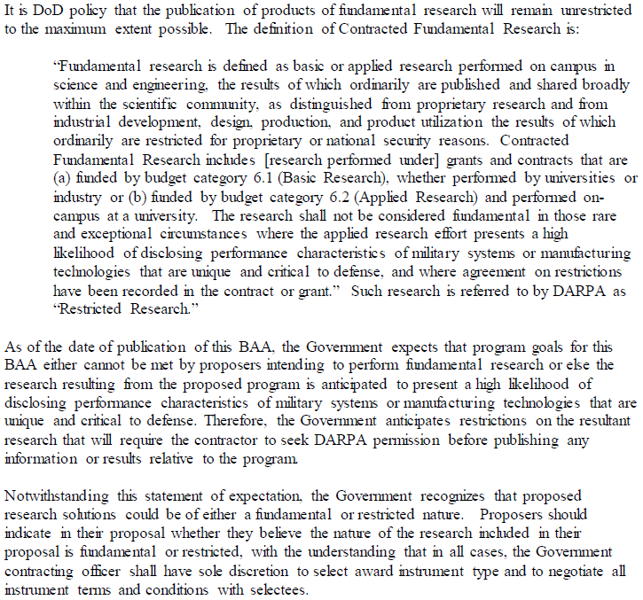
Example 5: Award Info

Slide 28
Example 6: Contractual Dissemination Restriction
Proscription
204.404-70 Additional contract clauses.
(a) Use the clause at 252.204-7000, Disclosure of Information, in solicitations and contracts when the contractor will have access to or generate unclassified information that may be sensitive and inappropriate for release to the public.
DFAR 252.204-7000 “Disclosure of Information” (AUG 2013)
(a) The Contractor shall not release to anyone outside the Contractor's organization any unclassified information, regardless of medium (e.g., film, tape, document), pertaining to any part of this contract or any program related to this contract, unless—
(1) The Contracting Officer has given prior written approval;
(2) The information is otherwise in the public domain before the date of release; or
(3) The information results from or arises during the performance of a project that has been scoped and negotiated by the contracting activity with the Contractor and research performer and determined in writing by the Contracting Officer to be fundamental research in accordance with National Security Decision Directive 189, National Policy on the Transfer of Scientific, Technical and Engineering Information, in effect on the date of contract award and the USD (AT&L) memoranda on Fundamental Research, dated May 24, 2010, and on Contracted Fundamental Research, dated June 26, 2008, (available at DFARS PGI 204.4).
(b) Requests for approval under paragraph (a)(1) shall identify the specific information to be released, the medium to be used, and the purpose for the release. The Contractor shall submit its request to the Contracting Officer at least 10 business days before the proposed date for release.
(c) The Contractor agrees to include a similar requirement, including this paragraph (c), in each subcontract under this contract. Subcontractors shall submit requests for authorization to release through the prime contractor to the Contracting Officer.

Slide 29
Question
Is the 252.204-7000 the only problematic clause?
No, there are numerous others and any specific language in Section H of a contract, or added as an addendum can have the same force and effect.
  AFMC 5352.227-9000 Export Controlled Data Restriction
  Section H: Sensitive Foreign National Controls

Slide 30
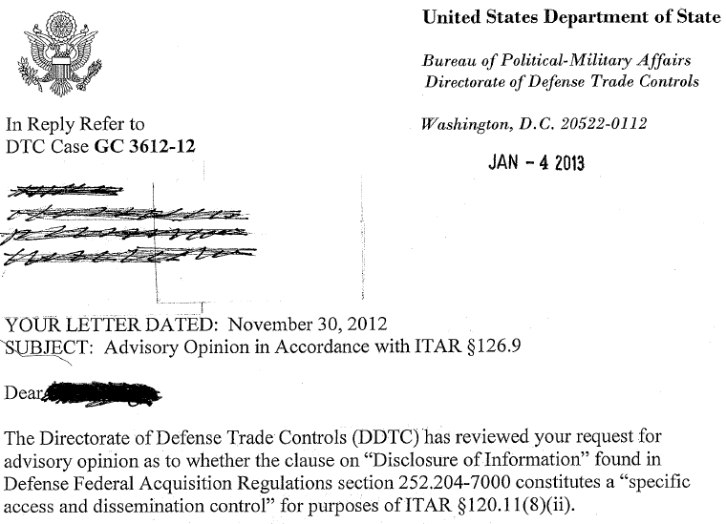

DoS General Correspondence

Slide 31
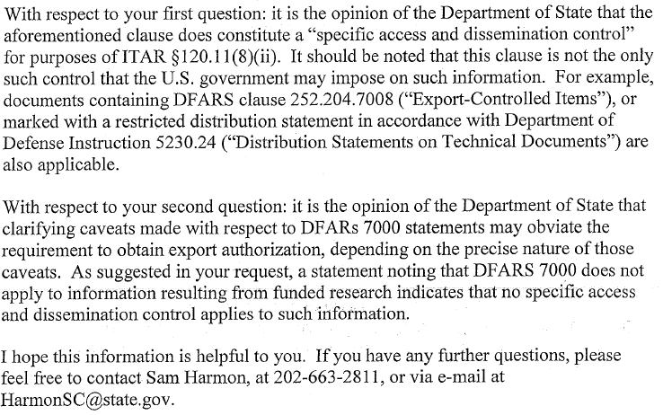

Slide 32
Question
Does an access, dissemination, publication or participation restriction have to be in the form of a clause?
No, it can be anywhere in a contract, or a verbal agreement. Examples:
  Funding type
  Distribution statement
  DD2345

Slide 33
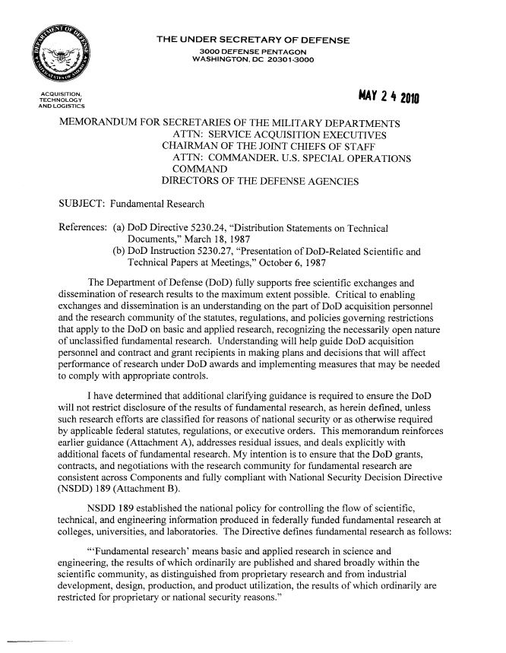
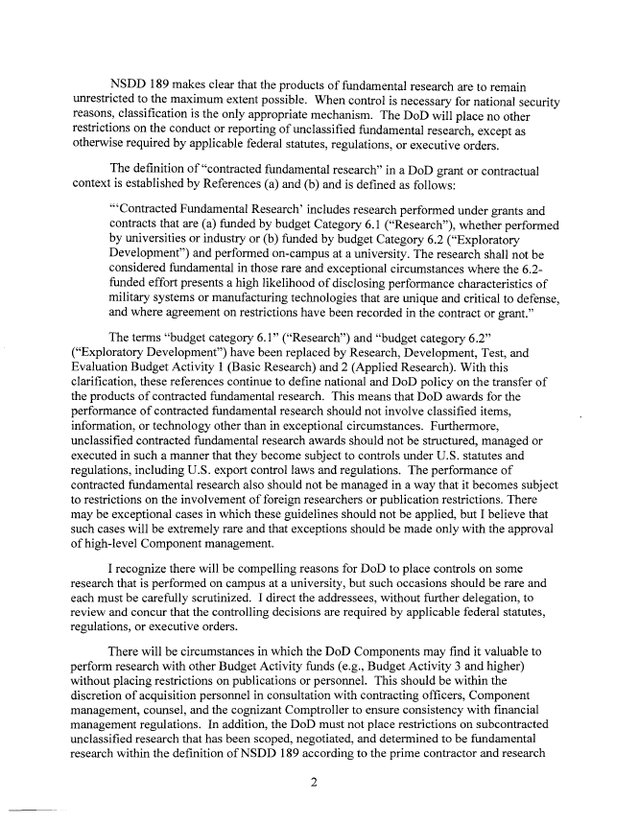
Ashton Carter Memo

Slide 34
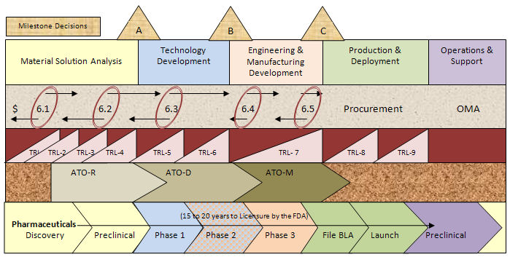
Example 7: TRL / Budget Category
Budget Activity | Technology Readiness Level
6.1, basic research | TRL 1, basis principles observed and reported
6.2, applied research | TRL 2, 3 & 4, technology concept and/or application; hypothesis testing, experiment & verification in laboratory
6.3, advanced technology development | TRL 5, verification in relevant environment
6.4, demonstration and validation | TRL 6, system/subsystem model or prototype demonstration in relevant environment
6.5, engineering and manufacturing development | TRL 7, demonstration in planned operational environment
6.6, RDT&E management support | TRL 8, system qualified in actual environment
6.7, operational systems development | TRL 9, operational & deployed
Notes:
The “6.1,” “6.2” and “6.3” categories are often grouped together as “Science and Technology” . . . . This category includes basic research, applied research and advanced technology development. These programs contribute to a broad knowledge base with potential applications to a wide variety of military as well as civilian uses. S&T is separate from the “6.4 and higher categories, which are focused on the development and testing of specific weapons systems. Nearly all DoD support for R&D at colleges and universities comes from the S&T accounts.

Slide 35
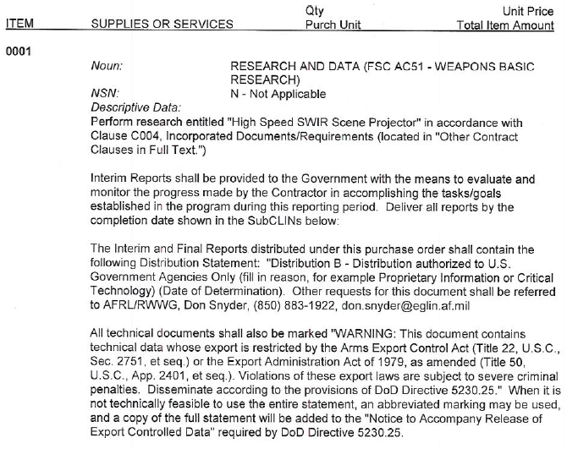
Example 8: CDRLs / Distribution Statements

Slide 36
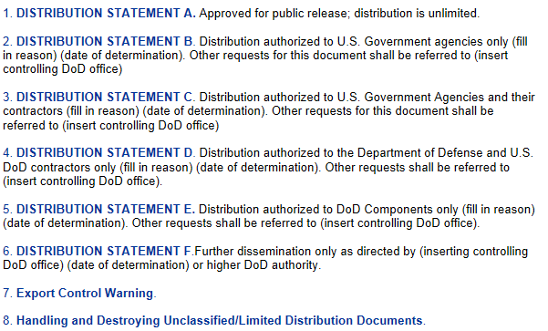
Distribution Statements
http://www.dtic.mil/dtic/submit/guidance/distribstatement.html

Slide 37
Question
Does a distribution statement mean a CDRL is subject to export controls?
No, it just means it is not fundamental research. It is subject to the EAR or the ITAR if the technology is specifically enumerated on a control list.

Slide 38
Non-Research Campus-wide Issues
International Travel to certain destinations with certain things
  Conference, presentations, field work
  Travel with equipment (including laptops, pda’s, data storage devices)
  Travel with unpublished or proprietary information
  Collaborating with specially designated people in foreign countries
Participation on certain projects
  International Collaborations , in U.S. or abroad
  Entity List Collaborations
Access to Certain Technology
  Foreign nationals (scholars & students) working in university labs
  Tangible ITAR USML controlled items on campus
Financial Assistance to certain places / people
  Financial, training or professional services to embargoed or sanctioned countries, entities or individuals
  Scholars receiving foreign assistance while working in a university lab

Slide 39
Denied Entities
Active in Florida
  Sichuan University - China
  Northwestern Polytechnical University (NWPU) – China
  Beihang University / Beijing University of Aeronautics and Astronautics (BUAA)
  University of Electronic Science and Technology of China (UESTC) - China
  Chinese Academy of Engineering Physics
  Ben Gurion University - Israel
  Pakistan Atomic Energy Commission, National Development Centre, etc. - Pakistan
  Civilian partnership with defense industry to improve educational training relevant to development of military technologies
Not Denied Entities, but known proliferators:
  Harbin Institute of Technology - China
  Nanjing University of Aeronautics & Astronautics - China
  Nanjing University of Science & Technology - China
http://www.bis.doc.gov/policiesandregulations/ear/744_supp4.pdf

Slide 40
Thanks!
Questions?

Slide 41
Backup

Slide 42
NASA China Assurance
Assurance for Grants / Cooperative agreements – case-by-case
Usually, Grants contain no restrictions. This is an exception!
Not an export control as it is not dependent on citizenship, but rather affiliation.
Not applicable to contracts (as they are subject to EAR/ITAR)

Slide 43
What is the assurance?
Funding Restriction on:
  Collaborating w/ ANYONE with an affiliation w/ the Government of China on a NASA Grant/Cooperative Agreement, e.g:
    Employee of Chinese University
    U.S. student paid by Govt of China.

Slide 44
Assurance Certificate (Proposals)
Assurance of Compliance – China Funding Restriction (DEVIATION FEB 2012)
(iv) An Assurance of Compliance with The Department of Defense and Full-Year Appropriation Act, Public Law 112-10 Section 1340(a); The Consolidated and Further Continuing Appropriation Act of 2012, Public Law 112-55, Section 539; and future-year appropriations herein after referred to as “the Acts”, whereas:
(1) NASA is restricted from using funds appropriated in the Acts to enter into or fund any grant or cooperative agreement of any kind to participate, collaborate, or coordinate bilaterally with China or any Chinese-owned company, at the prime recipient level and at all subrecipient levels, whether the bilateral involvement is funded or performed under a no-exchange of funds arrangement.
(2) Definition: “China or Chinese-owned Company” means the People’s Republic of China, any company owned by the People’s Republic of China, or any company incorporated under the laws of the People’s Republic of China.
(3) The restrictions in the Acts do not apply to commercial items of supply needed to perform a grant or cooperative agreement.
(4) By submission of its proposal, the proposer represents that the proposer is not China or a Chinese-owned company, and that the proposer will not participate, collaborate, or coordinate bilaterally with China or any Chinese-owned company, at the prime recipient level or at any subrecipient level, whether the bilateral involvement is funded or performed under a no-exchange of funds arrangement.

Slide 45
China Assurance Questionnaire

